Slide 1
Body Mass Index and Pathway Dysregulation in Cancer
Riku Takei (MSc)
Supervisor: Assoc. Prof. Mik Black

Slide 2
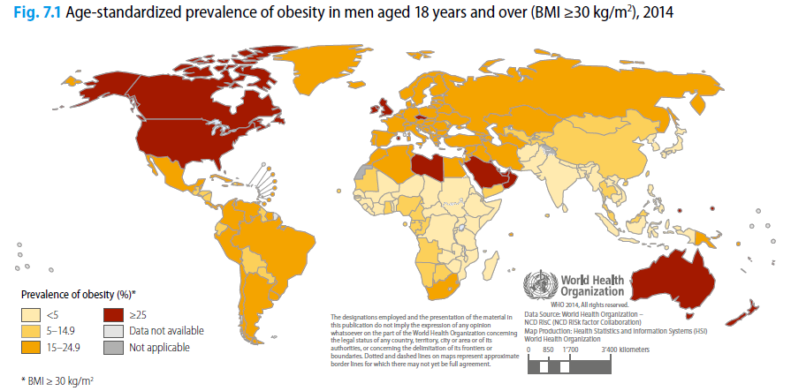
Introduction
WHO, 2014
Notes:
Obesity is becoming more prevalent in the world, especially in first world countries.
According to WHO, in 2014, 39% of the world population is overweight, and 11% of men and 15% of women are obese
This equates to more than half a billion adults who are obese

Slide 3
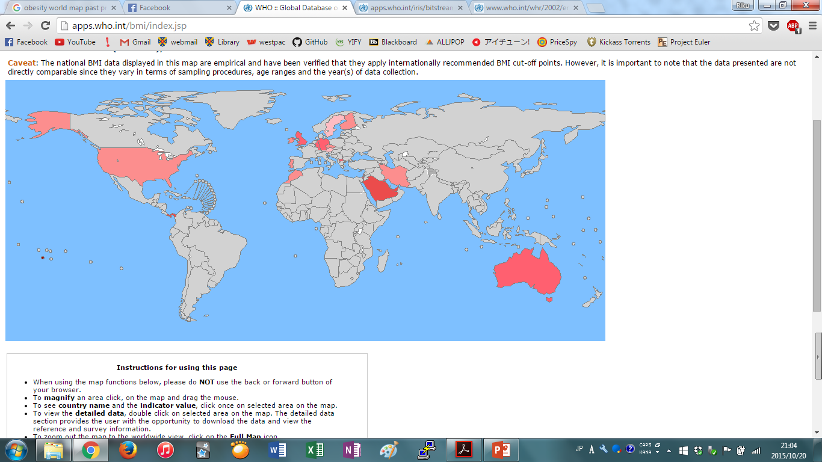
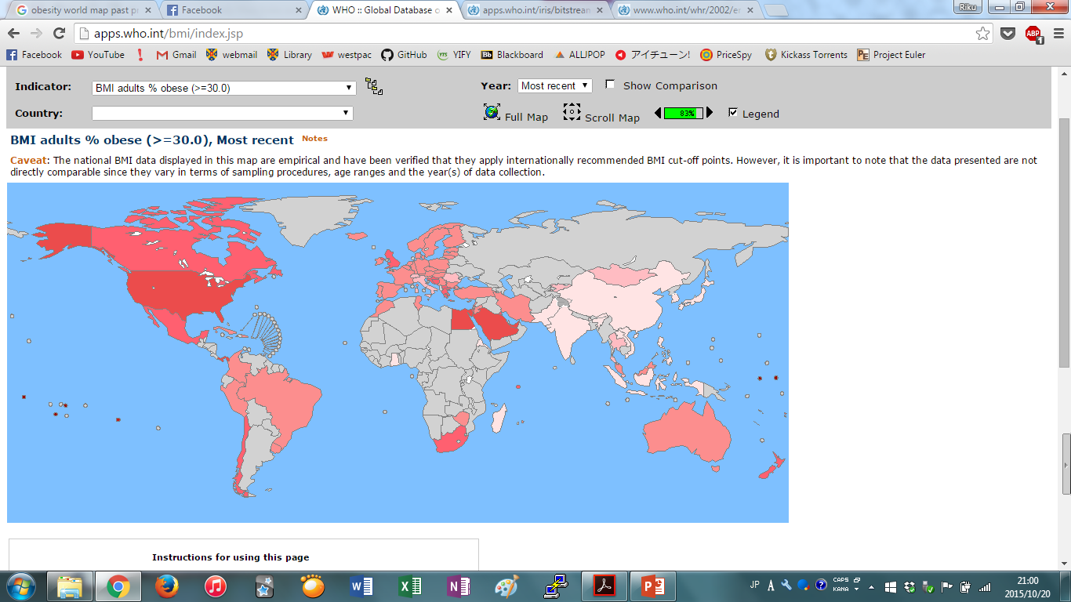
Introduction
1999
2014
WHO, 2015
Notes:
Obesity is becoming more prevalent in the world, especially in first world countries.
According to WHO, in 2014, 39% of the world population is overweight, and 11% of men and 15% of women are obese
This equates to more than half a billion adults who are obese

Slide 4
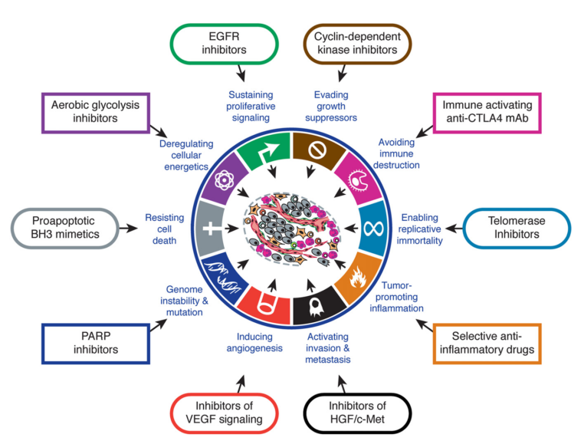
Body Mass Index and Cancer
Cancers are caused by dysregulation in various pathways that allow them to survive and proliferate
Hallmarks of Cancer (Hanahan and Weinberg, 2011)
Many reports on obesity being a major risk for cancer and poor prognosis
Hanahan and Weinberg, 2011
Notes:
This means that more people are getting obese, and when they get cancer, they will have poor prognosis and progress through cancer faster.
This will become a big problem in the future and need a good way to treat obese population effectively

Slide 5
Obesity-specific Genetic Signatures
Creighton et al. (2012)
Identified obesity-specific genetic signatures in breast cancer patients
Showed that some compounds were able to specifically regulate the expression of these genetic signatures (potential for targeted therapy)
Fuentes-Mattei et al. (2014)
Identified obesity-specific genetic signatures in ER+ breast cancer patients
Direct evidence of how obesity/adiposity contributes to tumour growth by using mouse model
Notes:
Previous studies have shown obesity-specific gene signatures in breast cancers

Slide 6
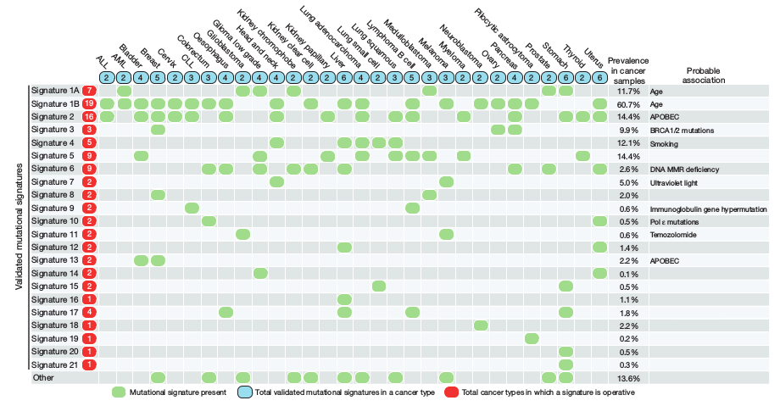
Genetic Signatures Across Multiple Cancer Types
Alexandrov et al., (2013)
Can we generalize the obesity-specific genetic signatures to other cancer types?
Notes:
Previous studies have shown that there are genetic signatures common in multiple cancer types.

Slide 7
Aims
Investigate the association between patient BMI and tumour molecular characteristics
Determine whether pathway commonalities exist across tumours that arise from other tissues
Notes:
Is there any relationship between BMI and genetic signatures that has been previously presented
Find genes that are differentially expressed in tumours from obese samples in different cancer types, and then investigate whether these genes are involved in similar pathways or not (then you’re able to provide common obesity-specific pathways to target for therapy)

Slide 8


Methods
Download sequence (RNA-seq) data and clinical data from publicly available databases
The Cancer Genome Atlas (TCGA)
International Cancer Genome Consortium (ICGC)
Images from: https://icgc.org/files/ICGC_Logo_eng_large.jpg and https://pbs.twimg.com/profile_images/467327840174616577/PXOnw28U.png

Slide 9
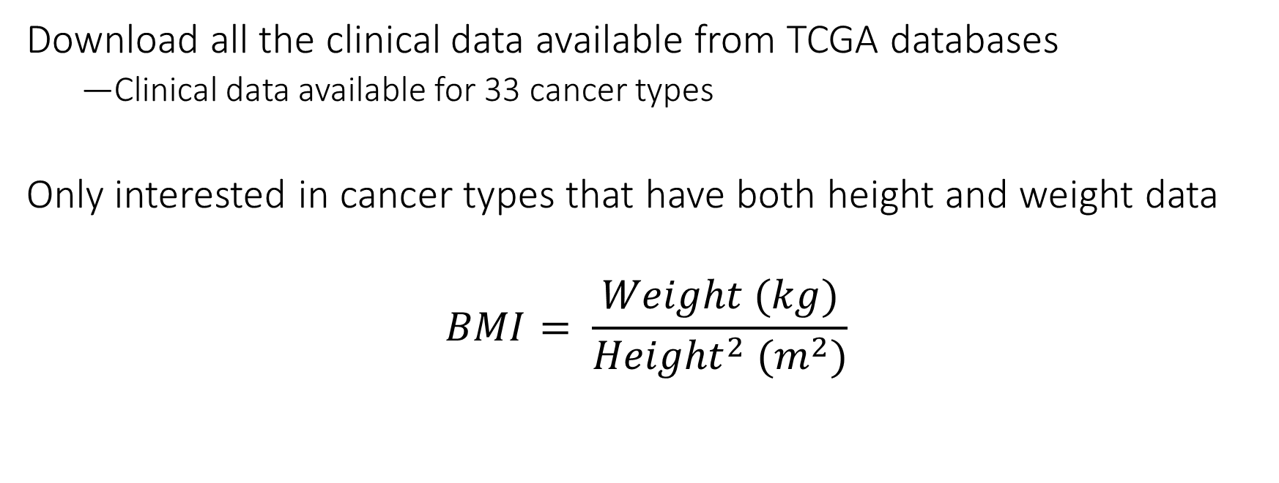
Clinical Data
Download all the clinical data available from TCGA databases
Clinical data available for 33 cancer types
Only interested in cancer types that have both height and weight data
$$BMI= \frac{Weight (kg)}{{Height}^{2} (m^{2})}$$

Slide 10
Clinical Data with Patient BMI
Out of 33 cancer types, 14 types had both height and weight data
UCEC has the highest number of samples available
BLCA | 349 | LIHC | 332
CESC | 262 | READ | 75
CHOL | 35 | SKCM | 249
COAD | 229 | THYM | 100
DLBC | 47 | UCEC | 512
ESCA | 174 | UCS | 52
KIRP | 157 | UVM | 53

Slide 11
RNA-seq DATA
Out of 14 cancer types, RNA-seq data was available for 8 cancer types
RNA-seq data was downloaded from the ICGC database
BLCA | 349 | LIHC | 332
CESC | 262 | READ | 75
CHOL | 35 | SKCM | 249
COAD | 229 | THYM | 100
DLBC | 47 | UCEC | 512
ESCA | 174 | UCS | 52
KIRP | 157 | UVM | 53

Slide 12
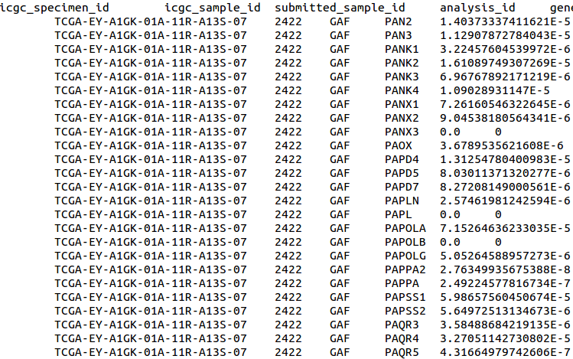
Data Processing
ICGC file format is terrible:
One sample with 20501 genes, then another sample, and so on…
For each cancer type, the data was processed into a matrix
X samples by 20501 genes

Slide 13
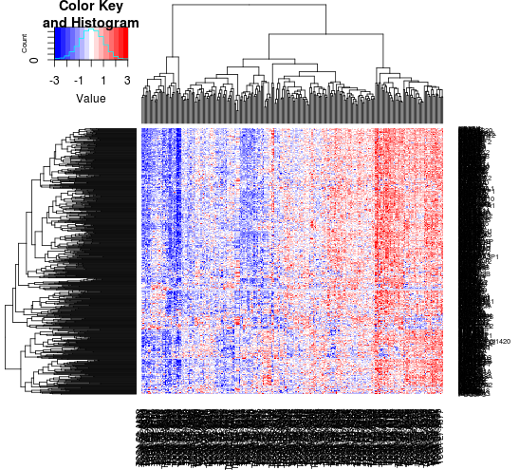
Data Standardisation
All of the cancer types were logged (base 10)
Data was standardized so that each gene had a mean = 0 and SD = 1
Account for genes with extremely low/high read counts

Slide 14
Singular Value Decomposition (SVD)
Each sample needs a “score” that represents the overall expression of the whole gene set in the data (e.g. 799 gene probes in Creighton et al. data)
Don’t want to make a single graph with 799 dimensions…
SVD allows you to squash the expression data into a single ‘metagene’ that represents the overall gene expression

Slide 15
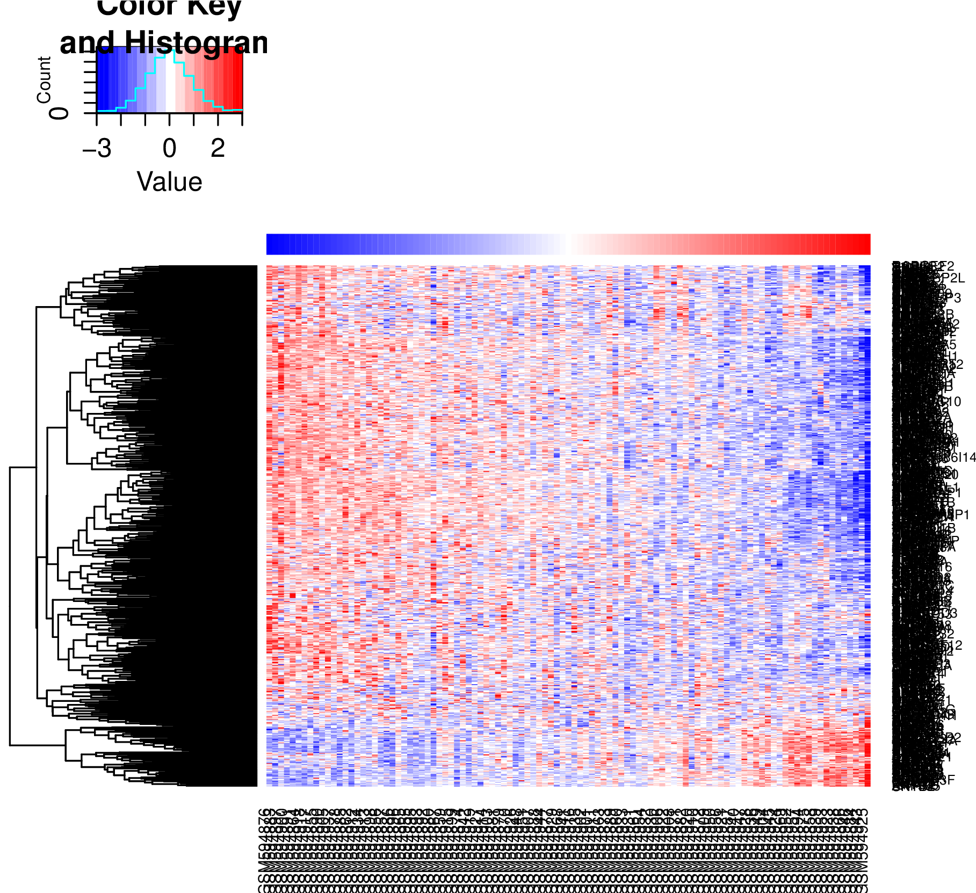
Example/Re-production – Creighton et al. (2012)
103 samples with 799 gene probes (695 unique genes)
Normalised the data using RMA normalization method (affy package)
Metagene obtained from SVD using 695 genes
Notes:
RMA = normalization method to account for the inter-array variability

Slide 16
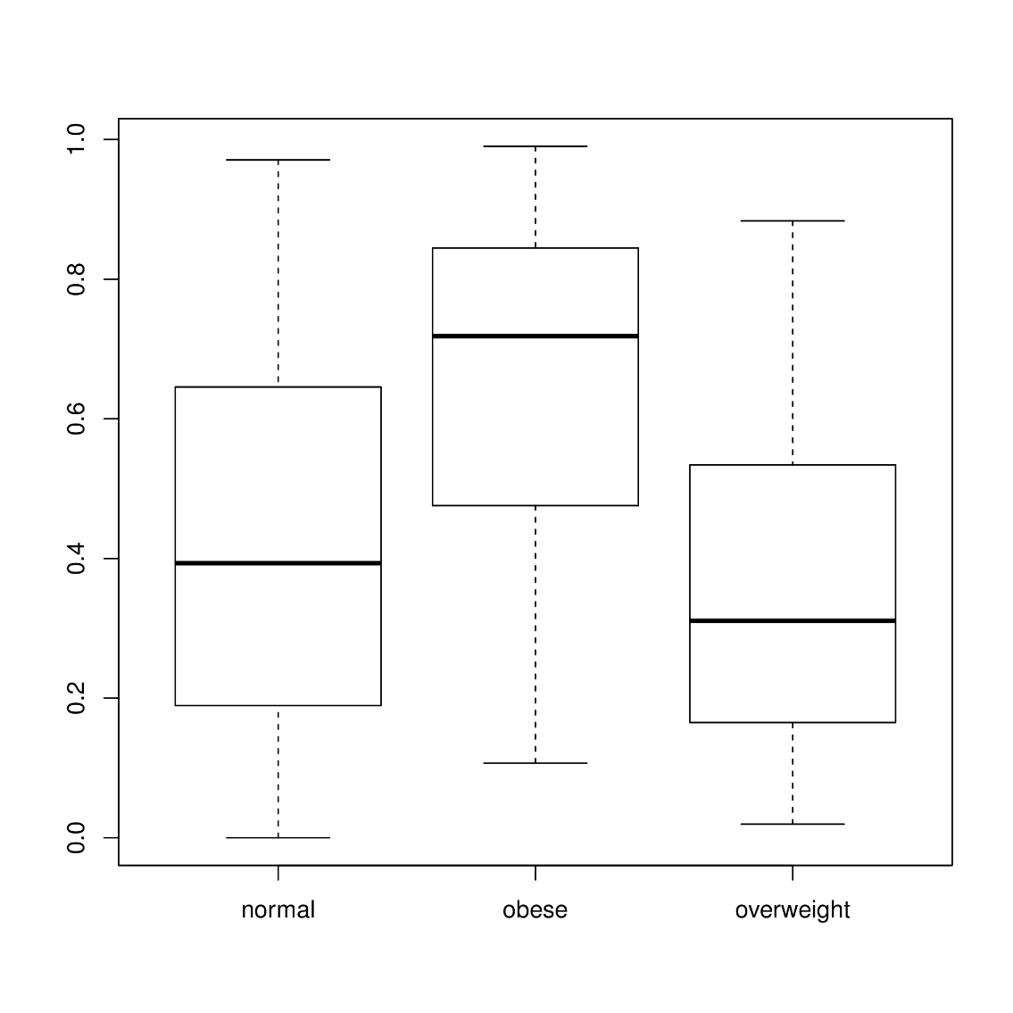
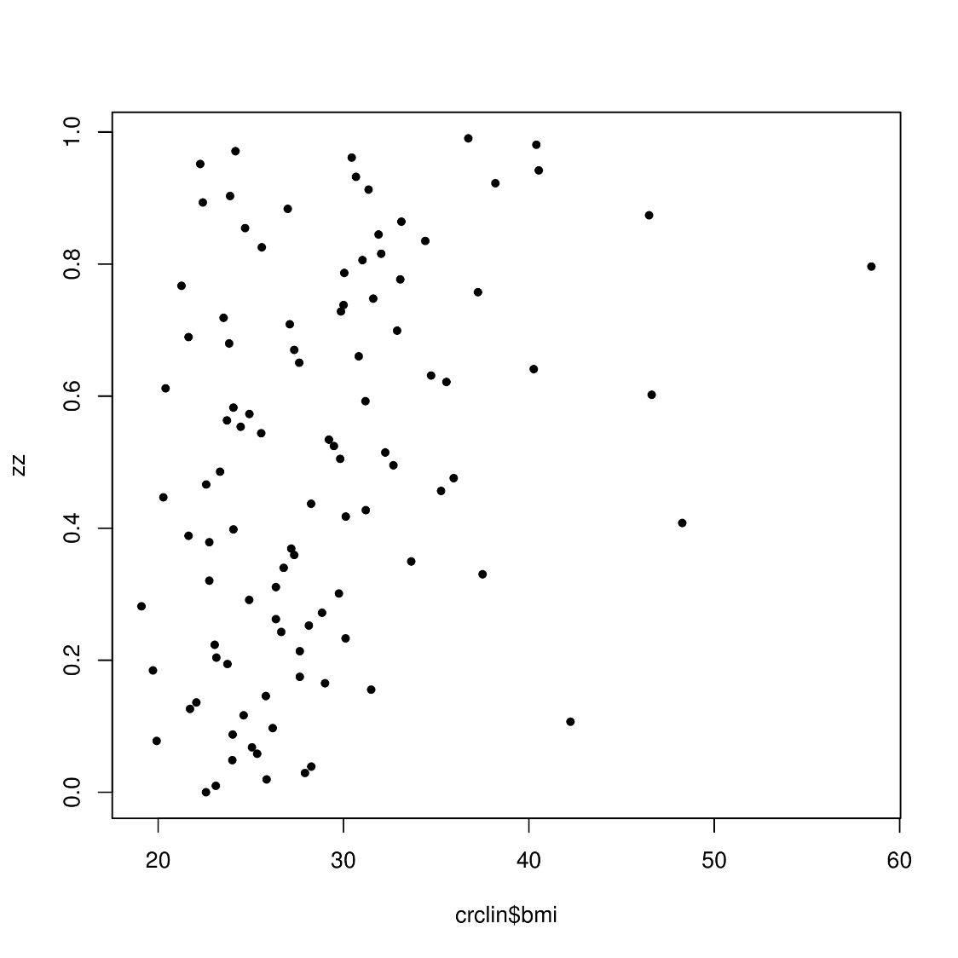
Creighton et al. Metagene Correlates with Body Mass Index

Slide 17
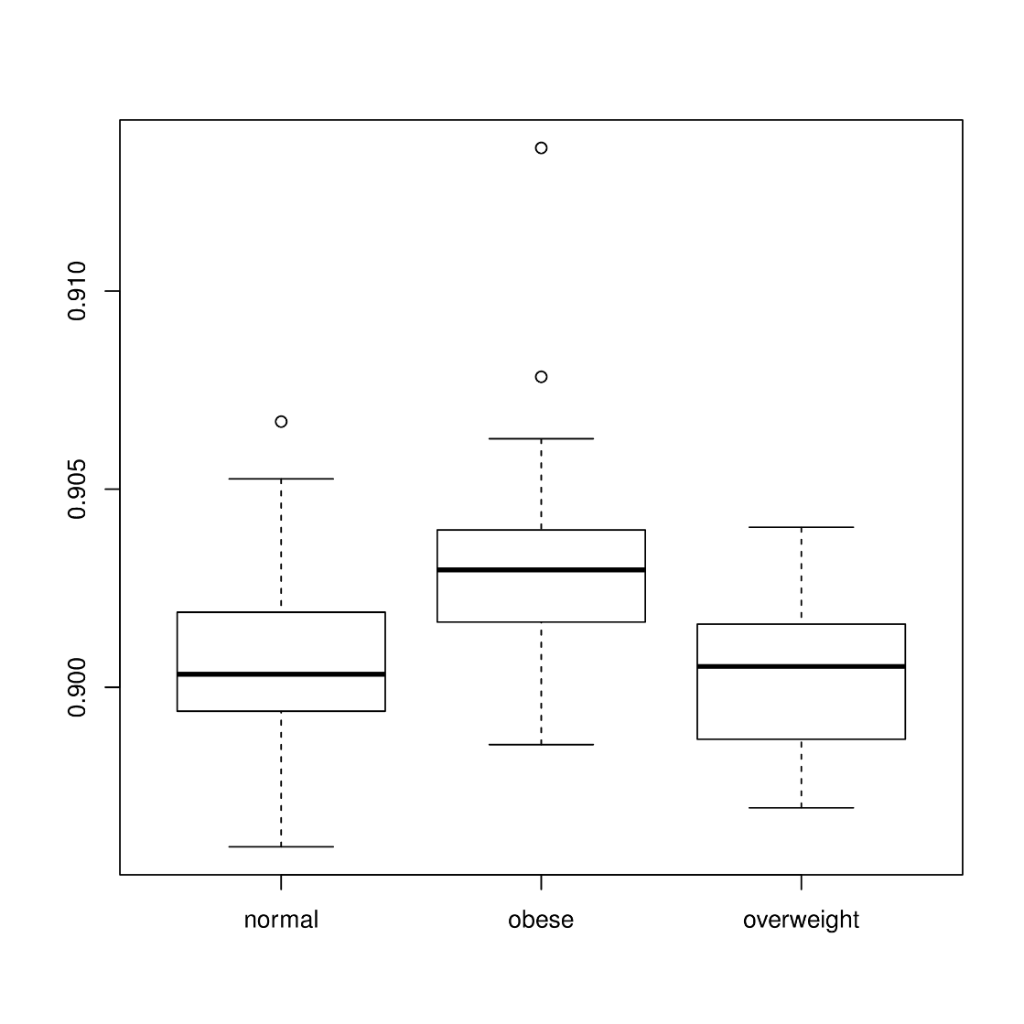
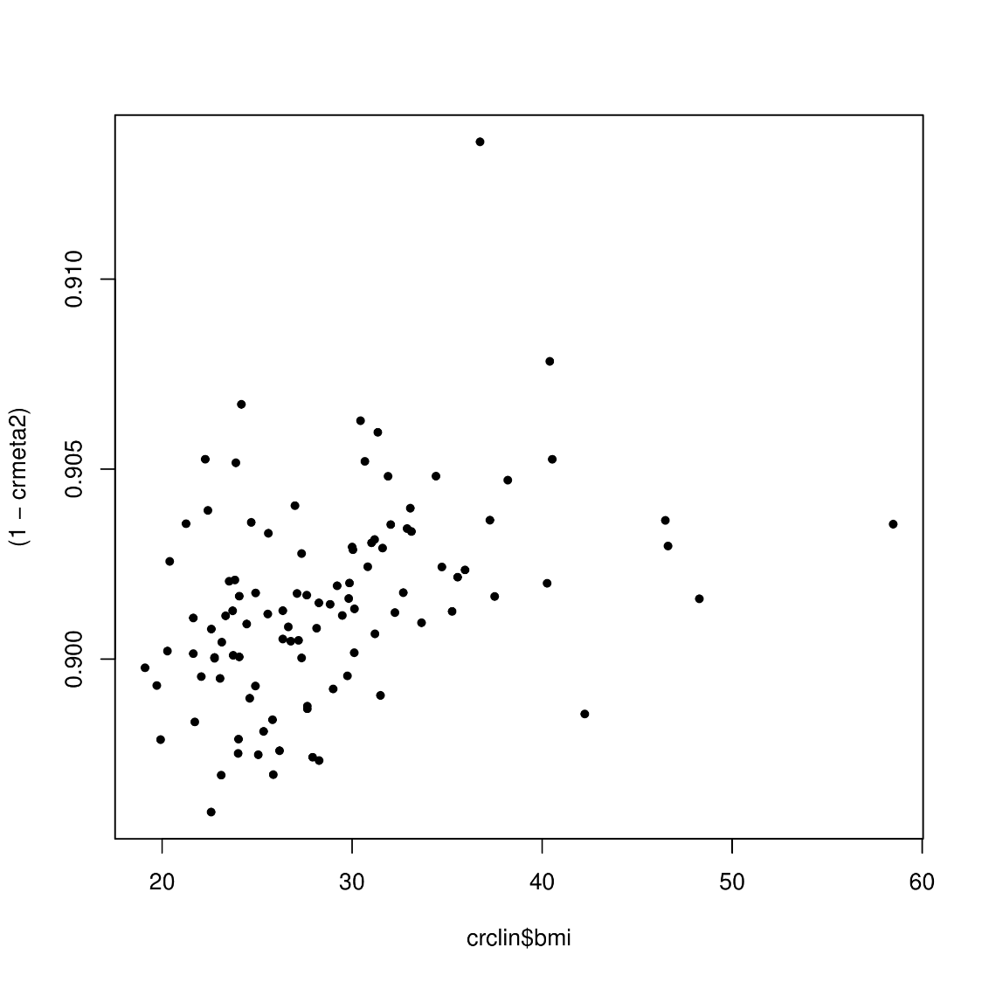
Creighton et al. Metagene Correlates with Body Mass Index

Slide 18
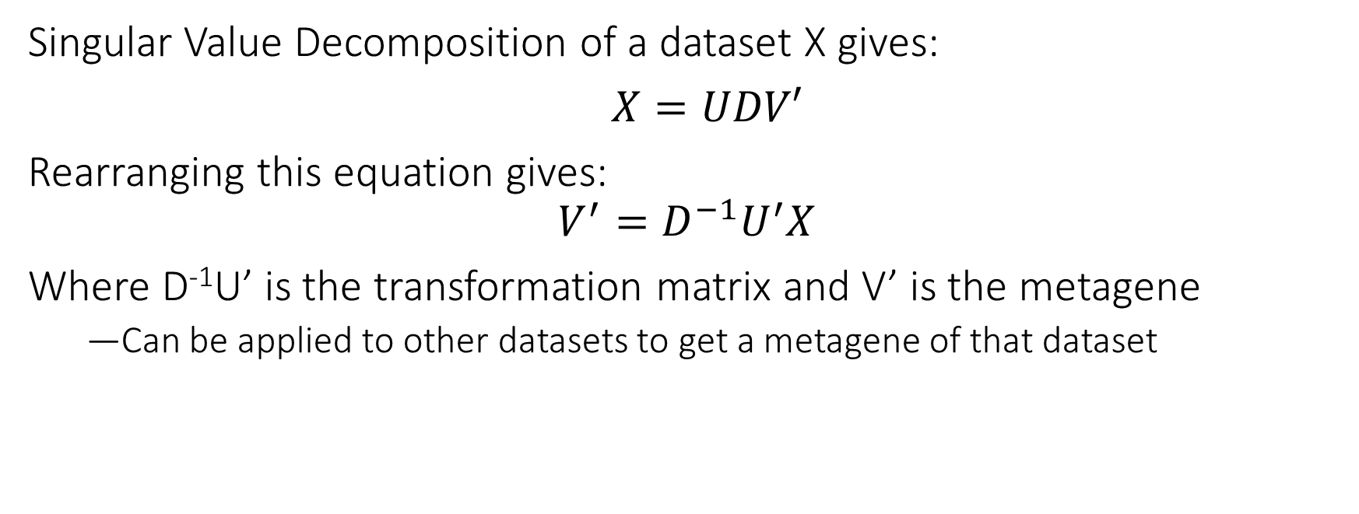
Transformation Matrix
Singular Value Decomposition of a dataset X gives:
$X=UDV′$
Rearranging this equation gives:
$$V^{′}={D^{−1}U}^{′}X$$
Where D⁻¹U’ is the transformation matrix and V’ is the metagene
Can be applied to other datasets to get a metagene of that dataset

Slide 19
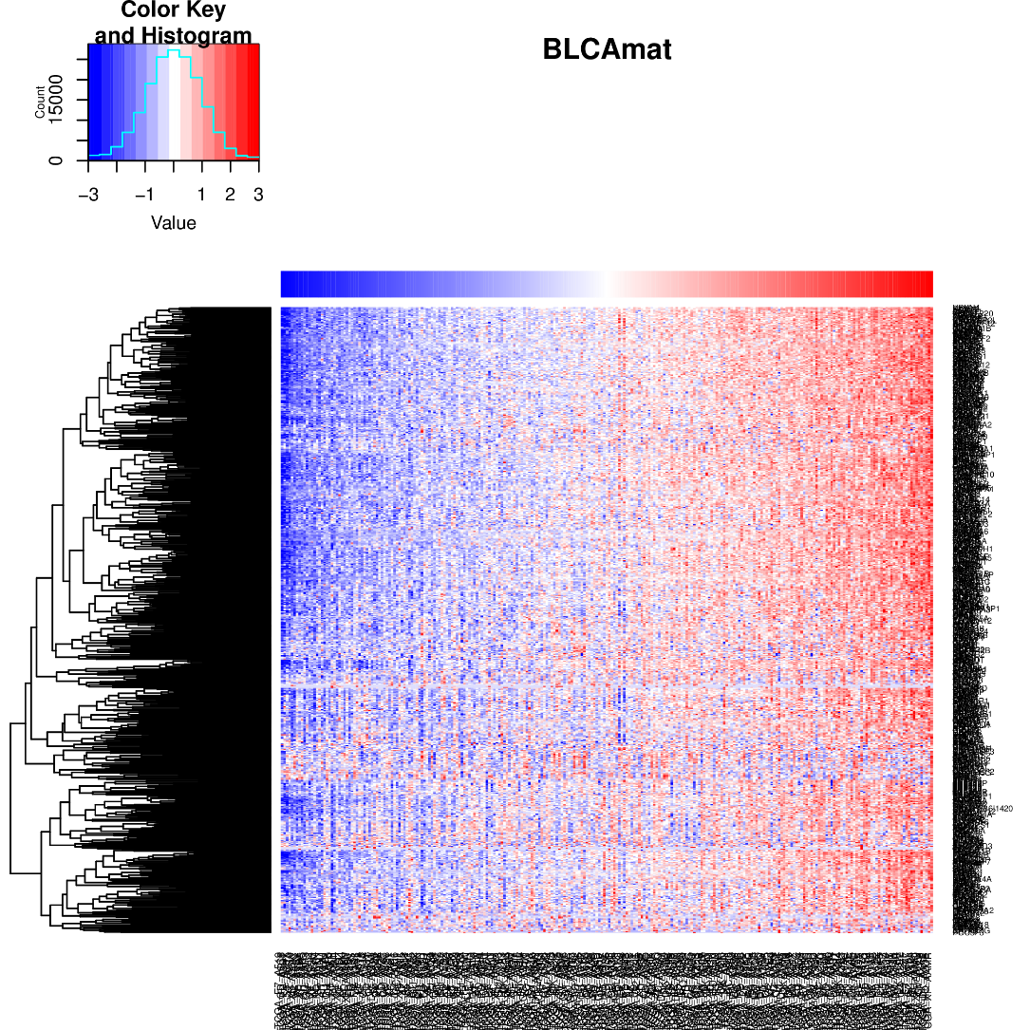
Results – Bladder Cancer (BLCA)
Bladder

Slide 20

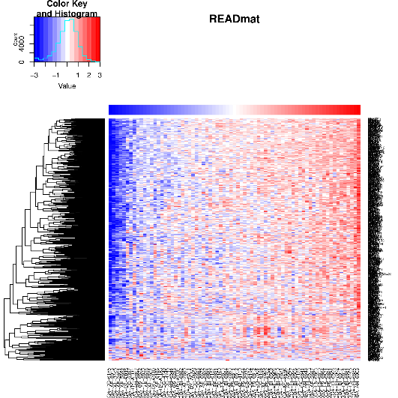
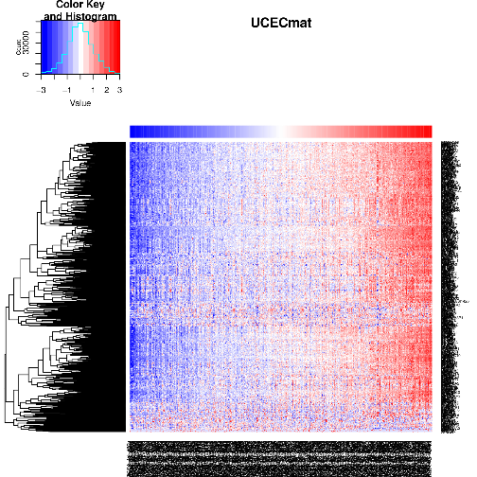

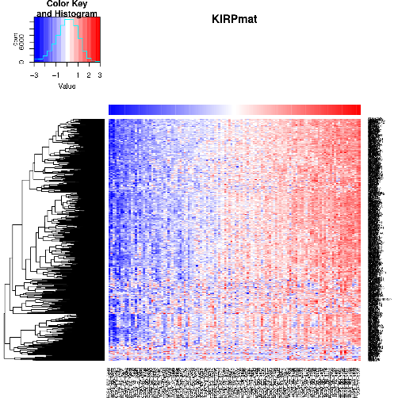
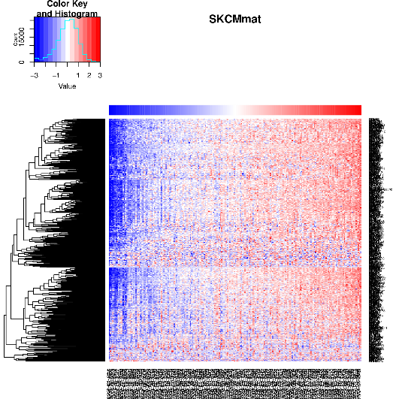

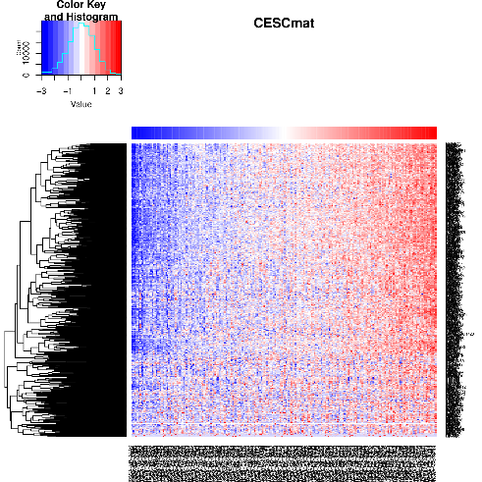
Results – Other Cancer Types
Bladder
Rectum
Endometrial
Colon
Kidney (papillary)
Skin
Liver
Cervical (squamous)

Slide 21
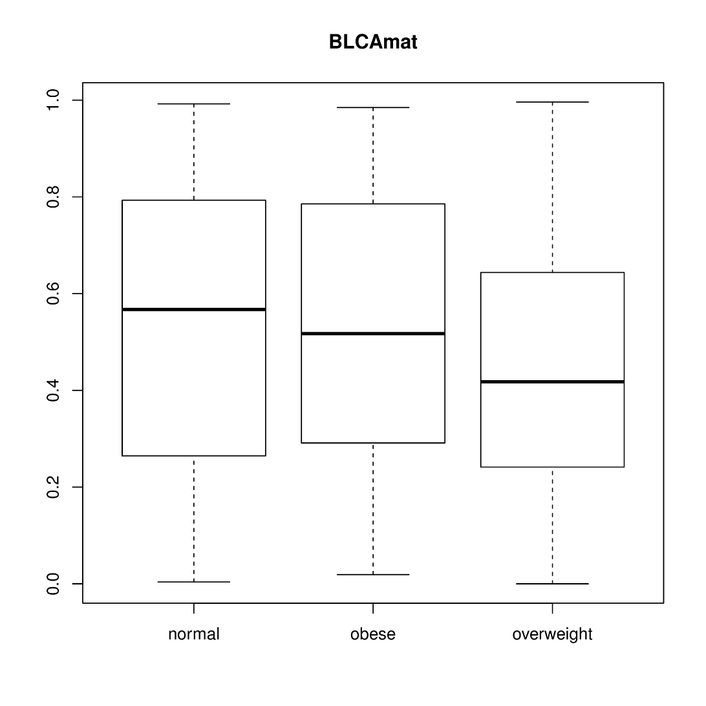
Results – Bladder Cancer (BLCA)
Bladder

Slide 22
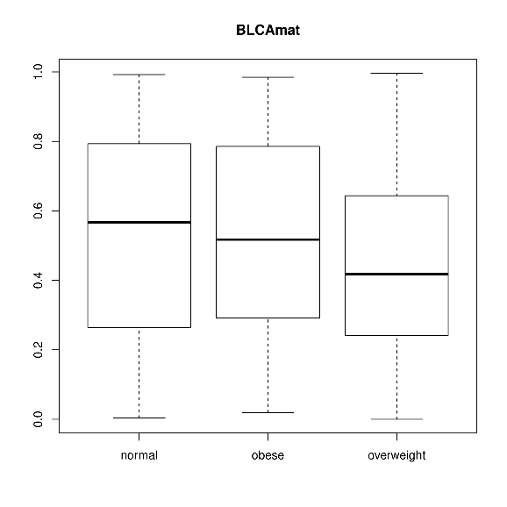
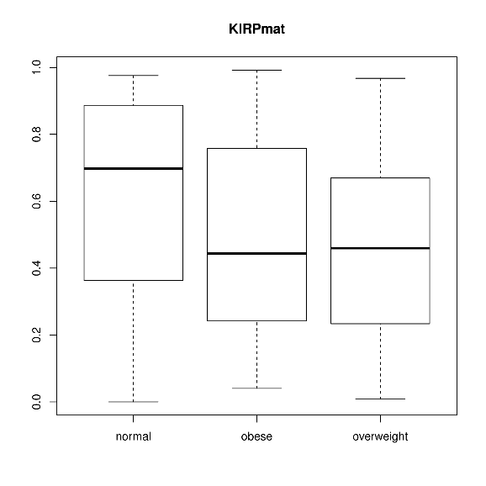
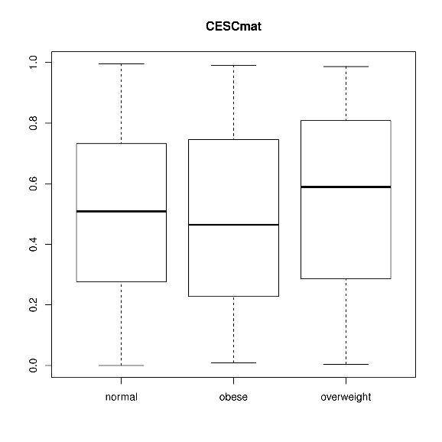
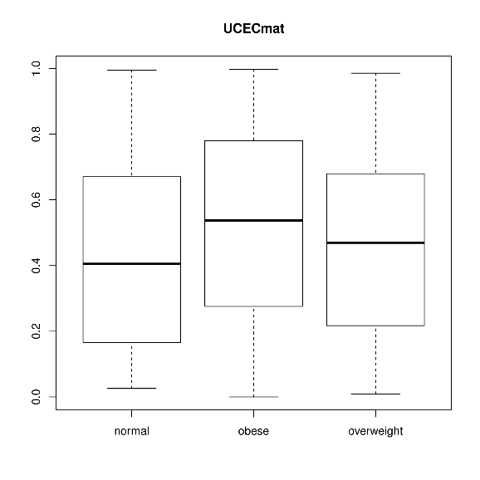
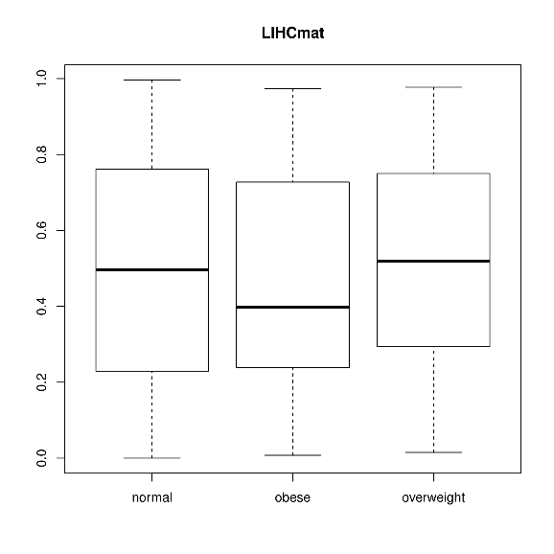
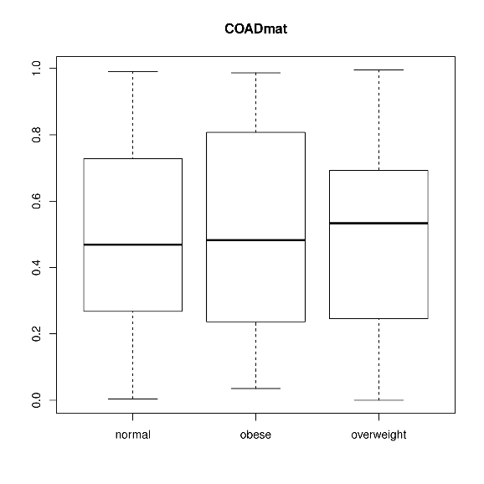
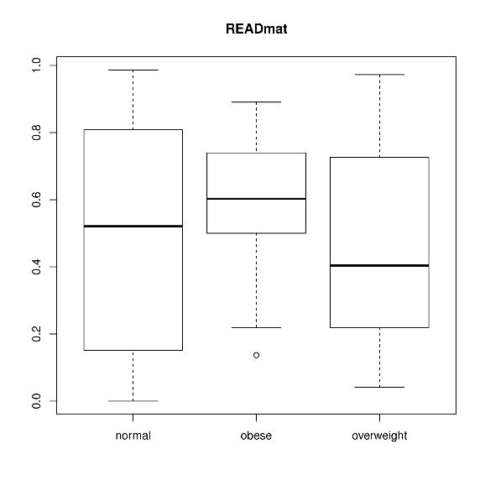
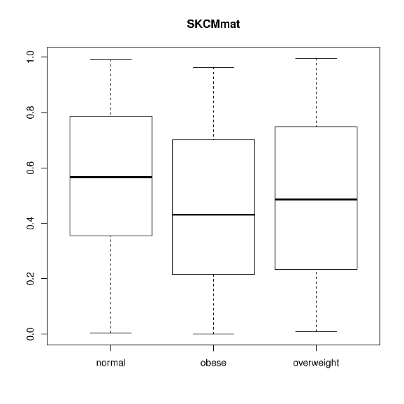
Results – Other Cancer Types
Bladder
Kidney (papillary)
Cervical (squamous)
Endometrial
Liver
Colon
Rectum
Skin

Slide 23
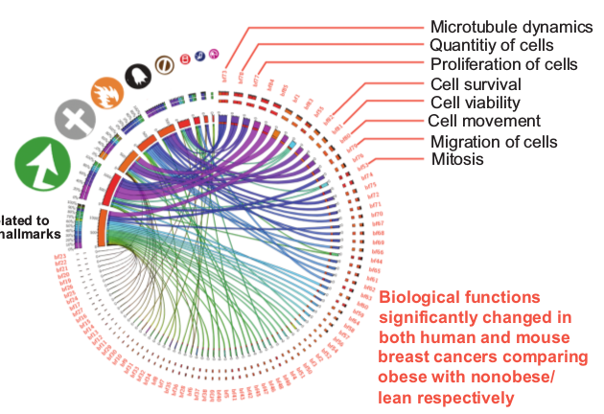
Fuentes-Mattei et al. (2014)
137 ER+ breast cancer samples with 111 unique genes
Data normalized with RMA
Metagene formed from SVD
No BMI information was avaialable
Fuentes-Mattei et al., 2014
Notes:
No BMI information was available, so we couldn’t validate whether SVD gave the same results

Slide 24
Can Fuentes-Mattei Metagene Predict BMI Status in Creighton et al. Dataset?
If both studies presented obesity-specific genetic signatures, then these signatures should be similar
Therefore able to separate the samples based on BMI, using the signature from one dataset on the other dataset
No BMI information is available for Fuentes-Mattei et al., so used Fuentes-Mattei et al. dataset to transform the Creighton et al. dataset
- Check whether the metagene generated correlates with BMI
Notes:
Creighton et al dataset have BMI information of the samples, so able to see if metagene correlates with BMI information

Slide 25
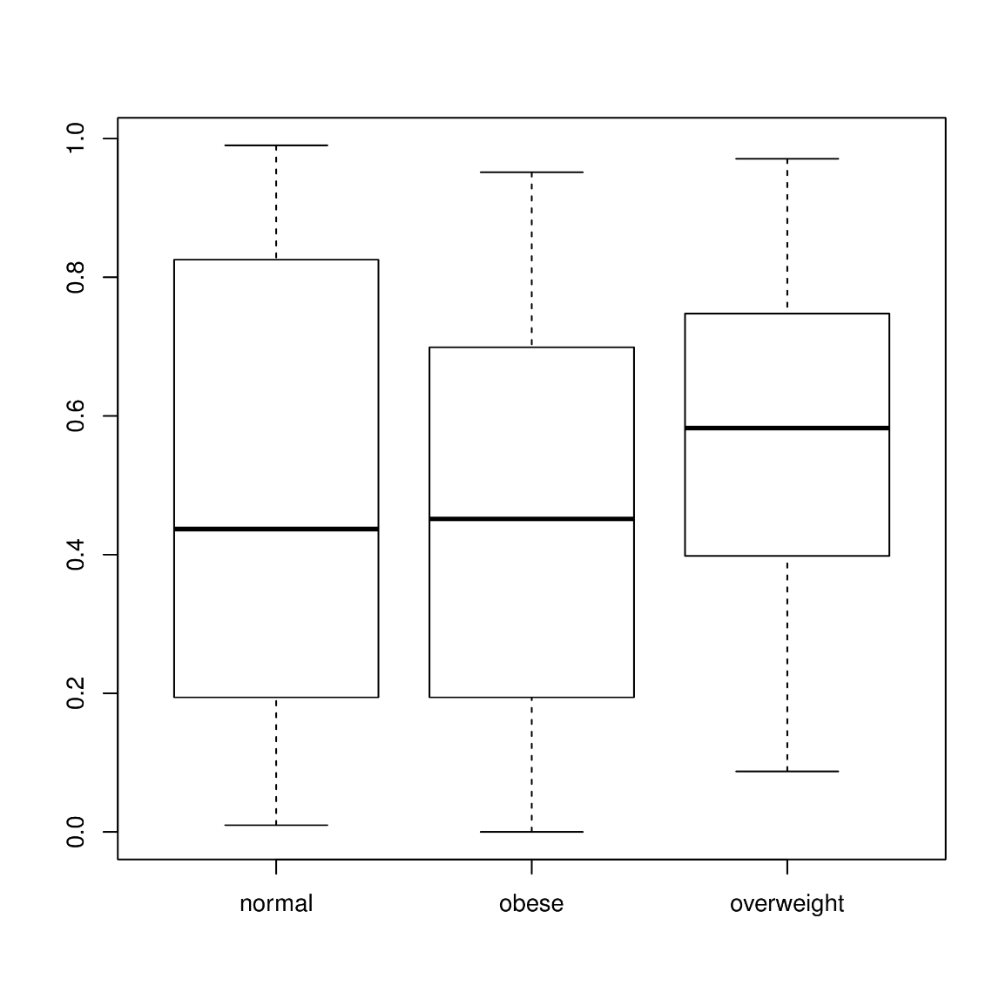
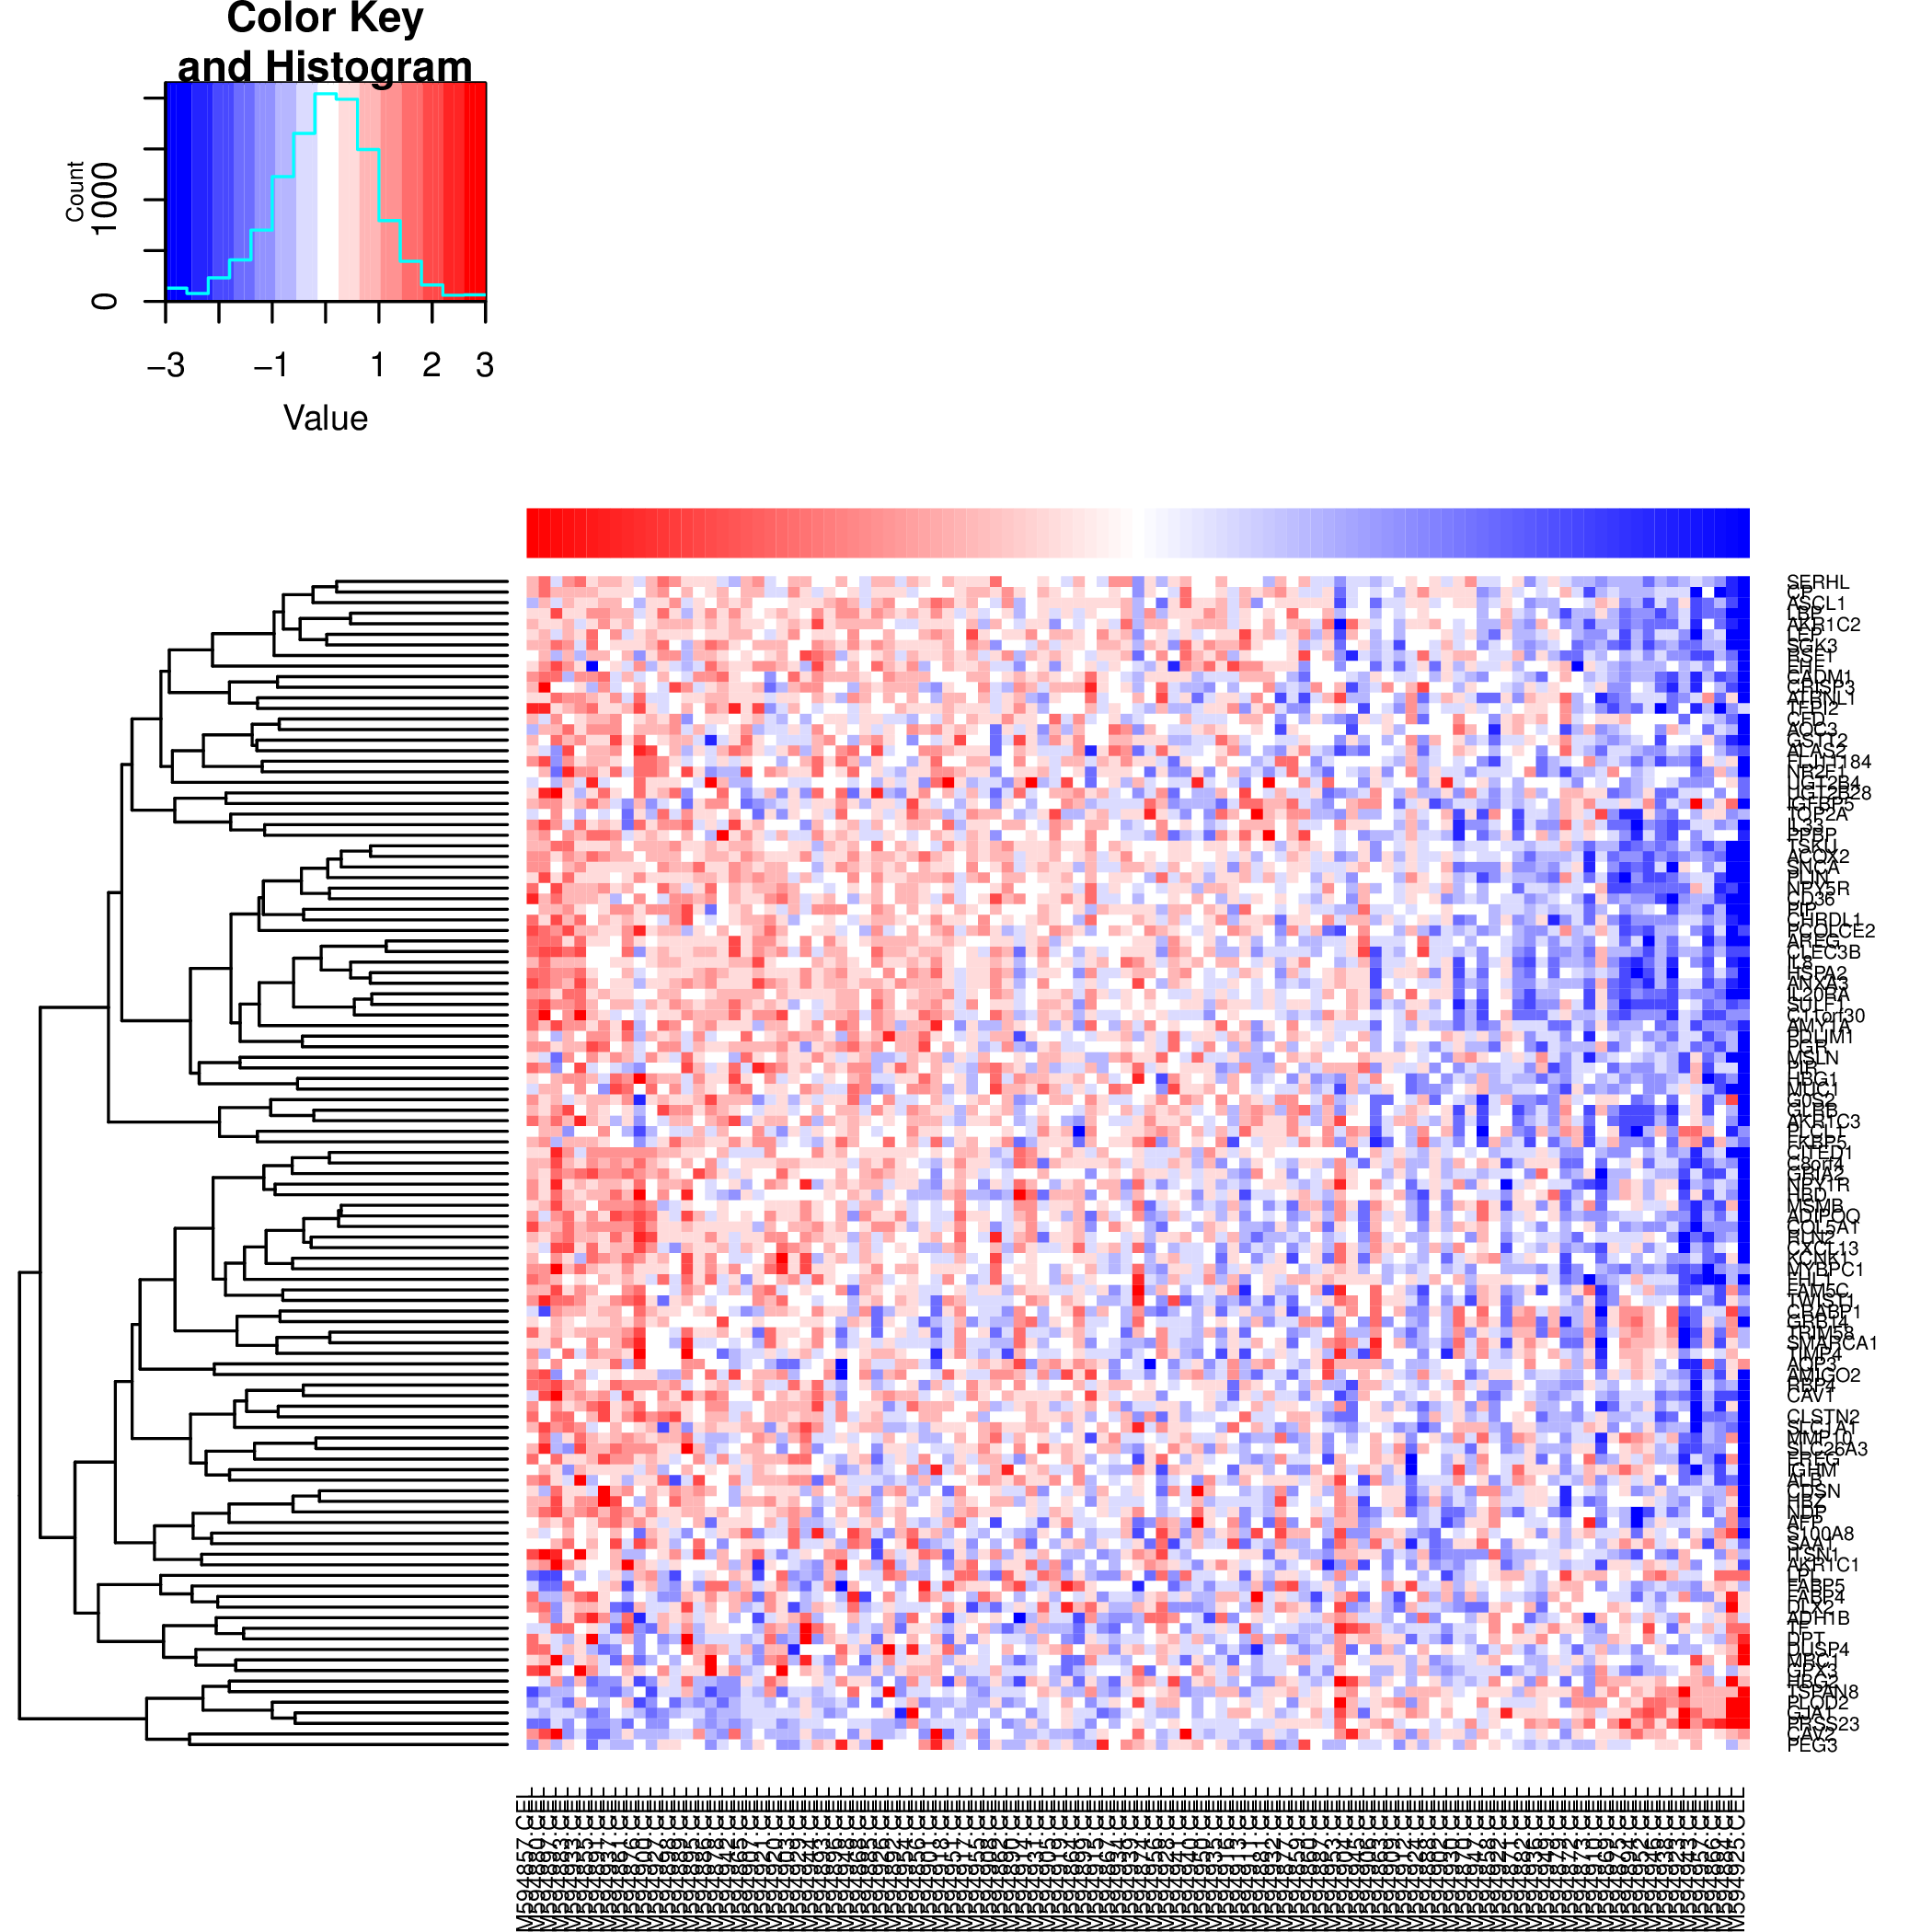
Can Fuentes-Mattei Metagene Predict BMI Status in Creighton et al. Dataset?

Slide 26
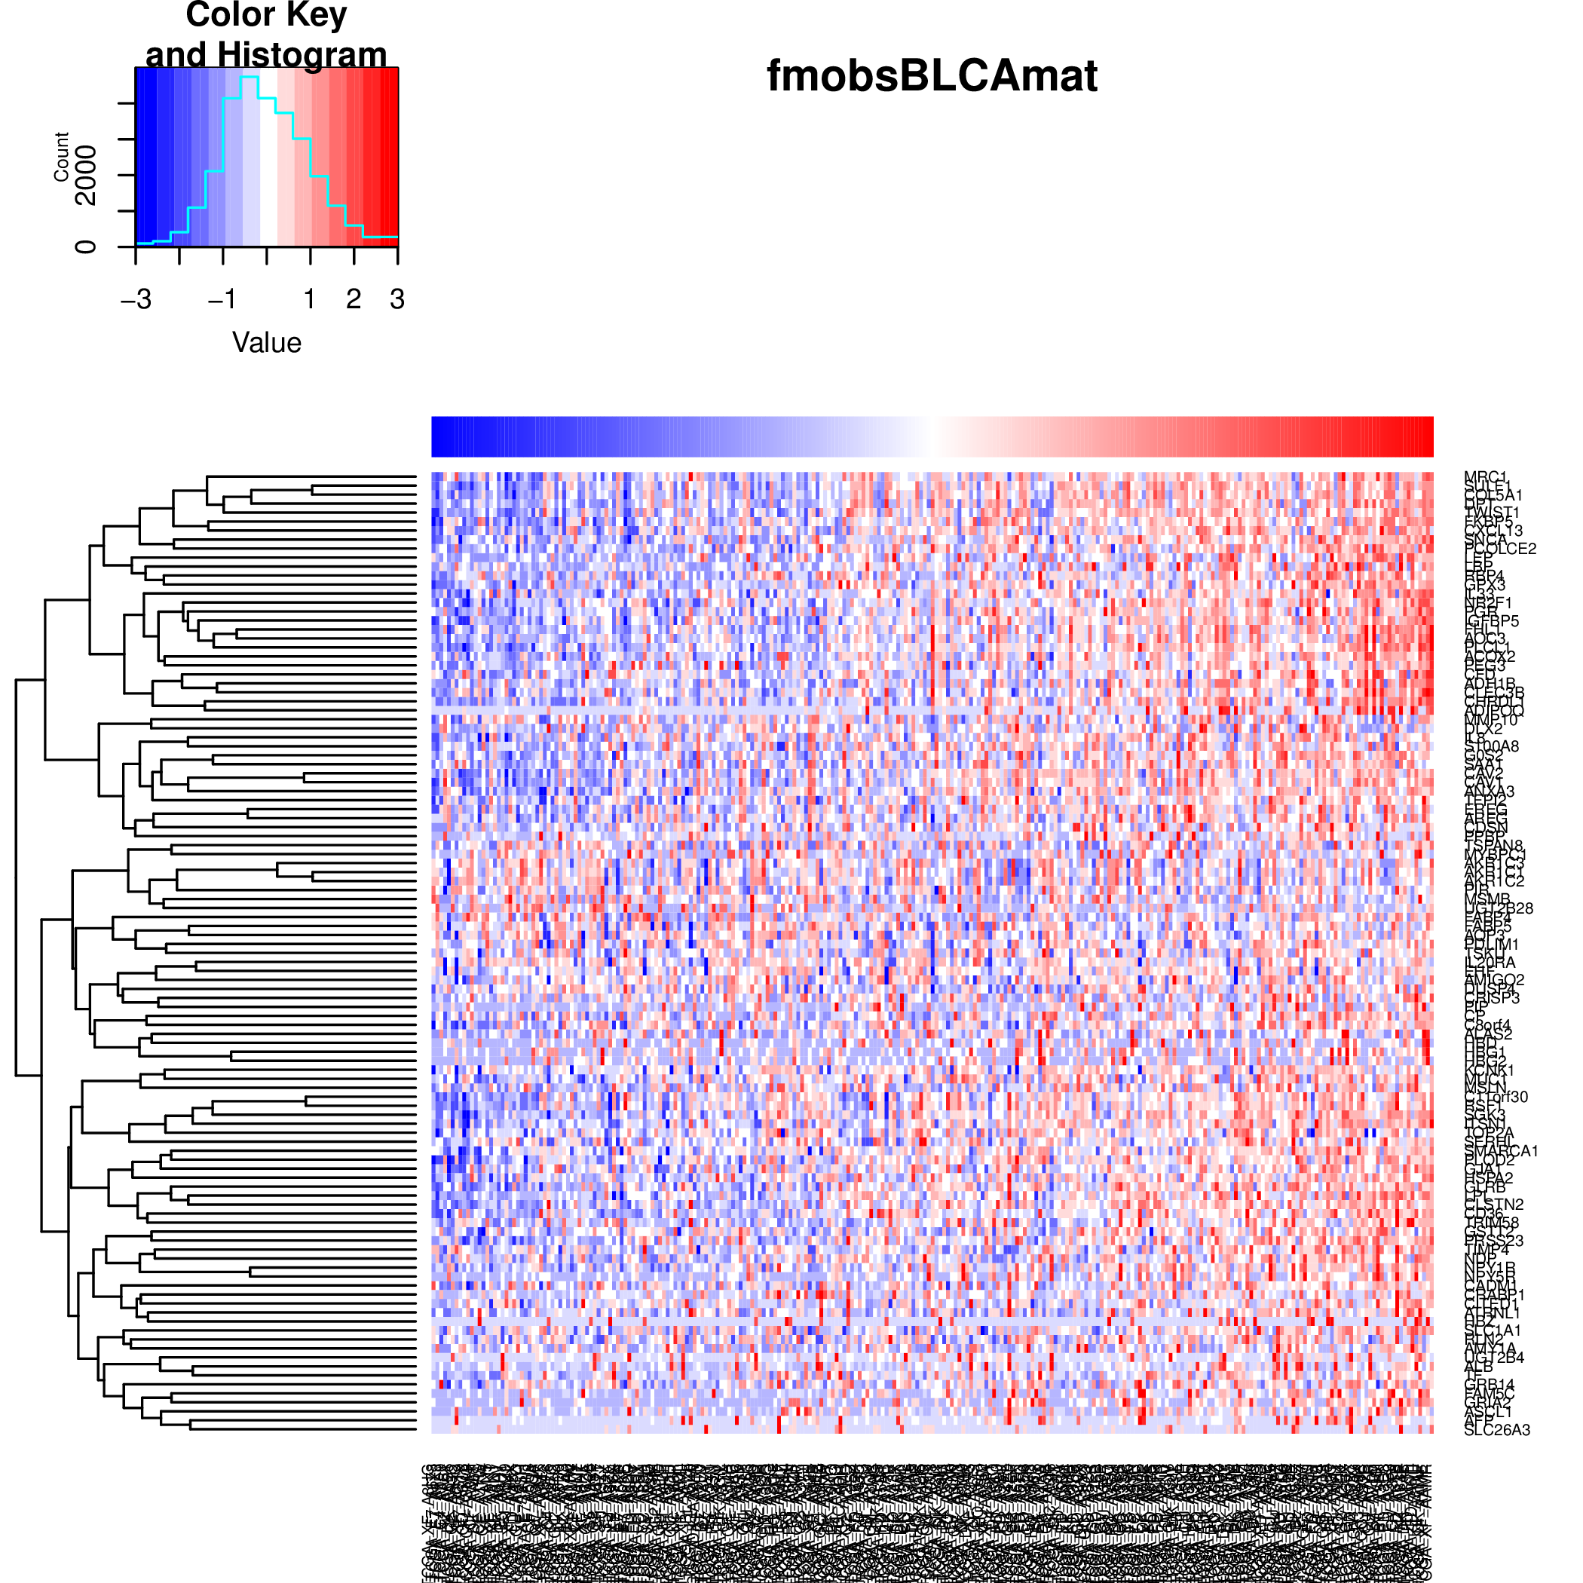
Results – Bladder Cancer (BLCA)
Bladder

Slide 27
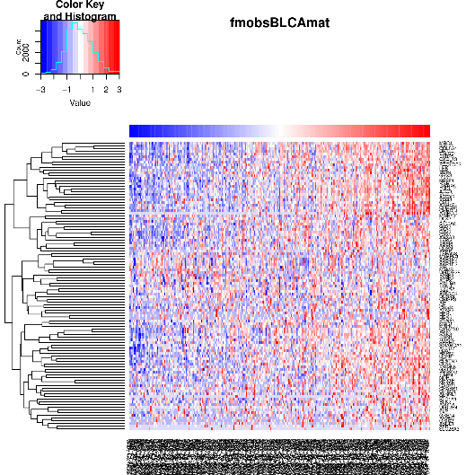
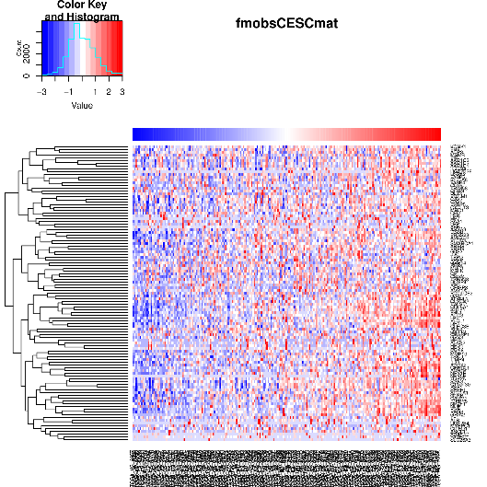
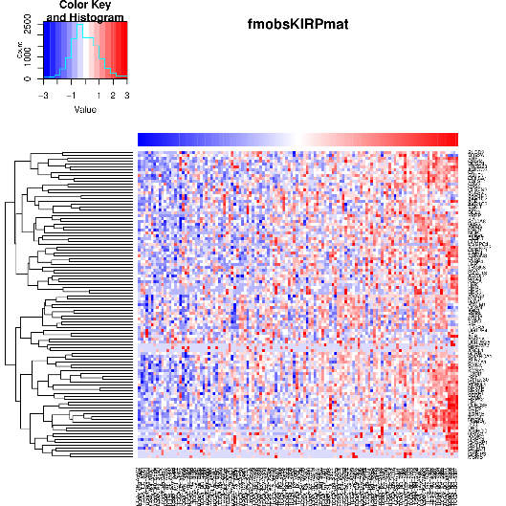
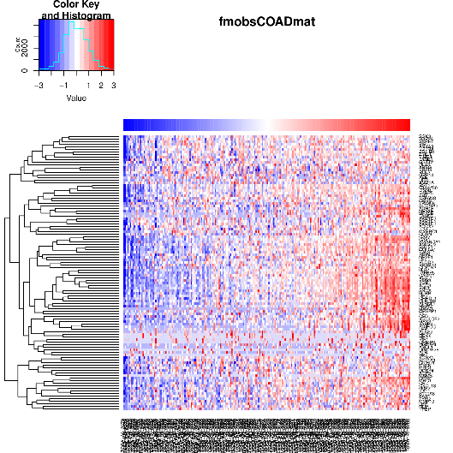
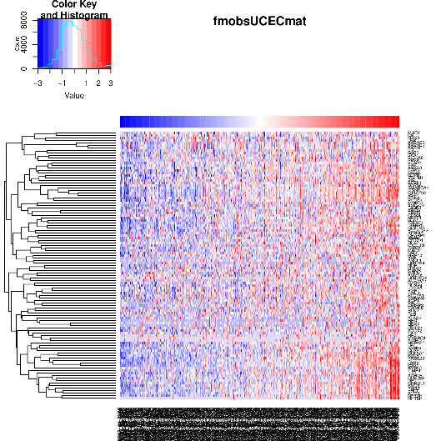
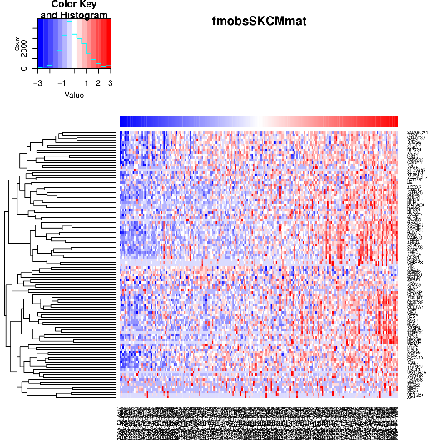

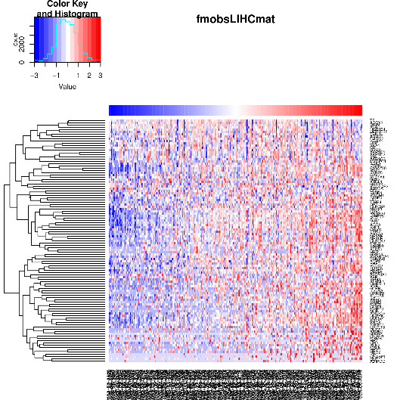
Results – Other Cancer Types
Bladder
Cervical (squamous)
Kidney (papillary)
Colon
Endometrial
Skin
Rectum
Liver

Slide 28
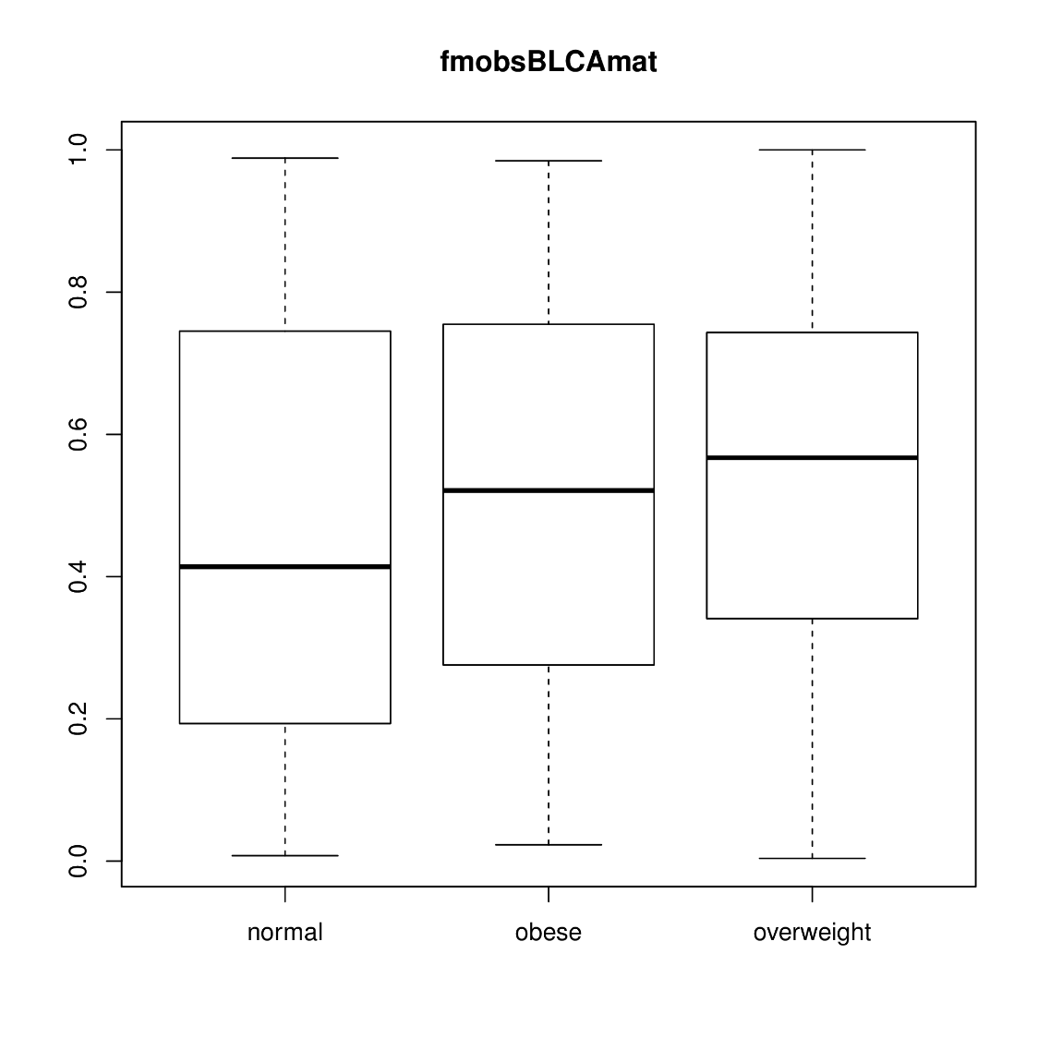
Results – Bladder Cancer (BLCA)
Bladder

Slide 29
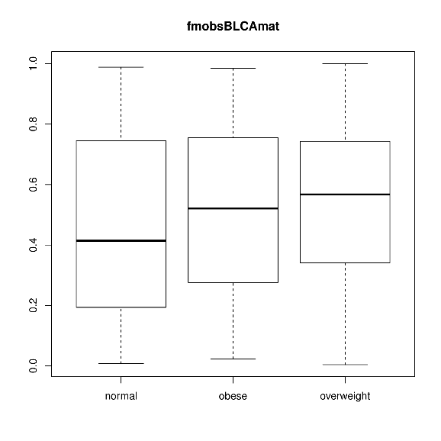
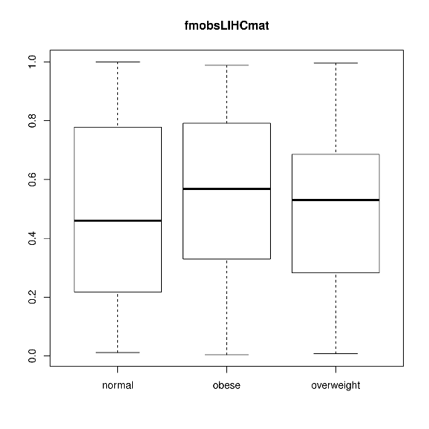
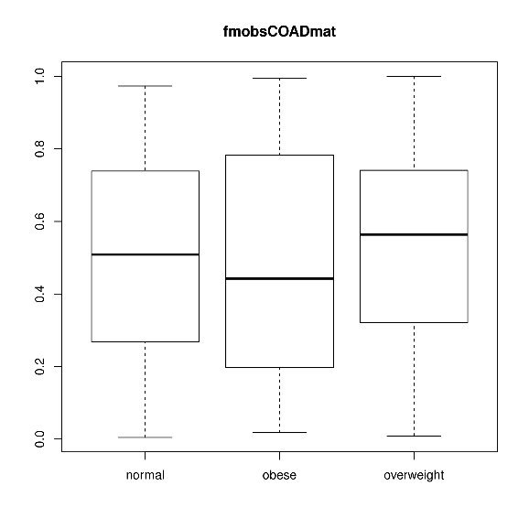
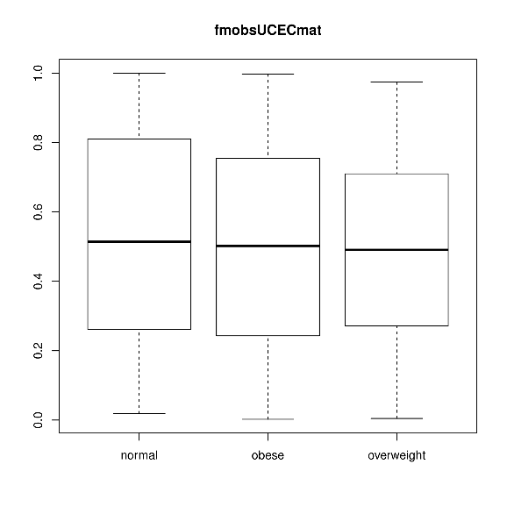
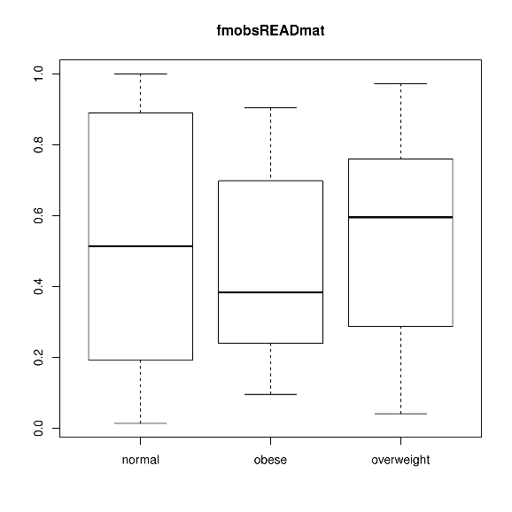
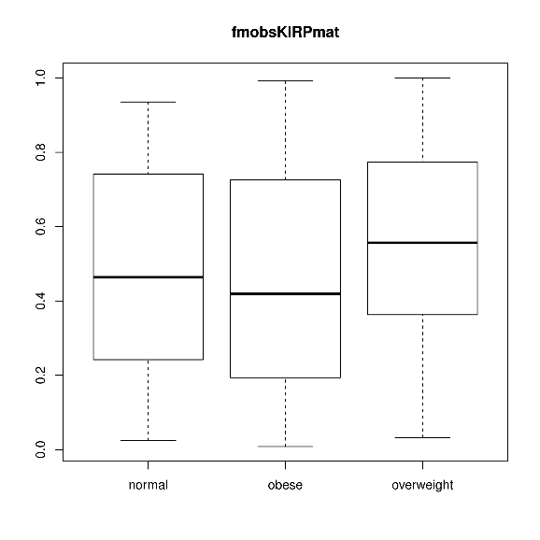
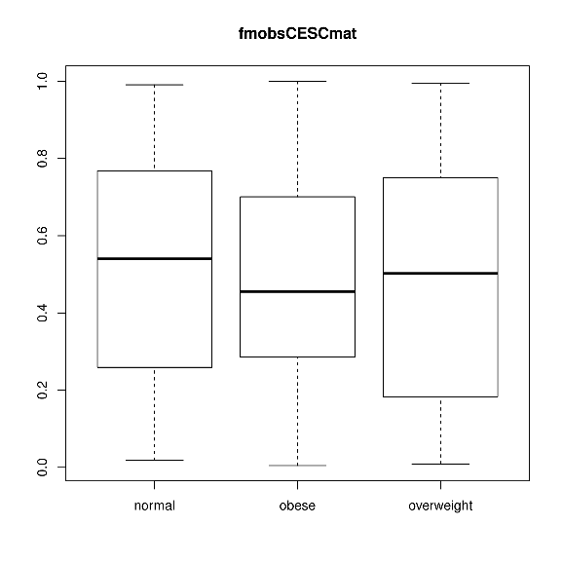
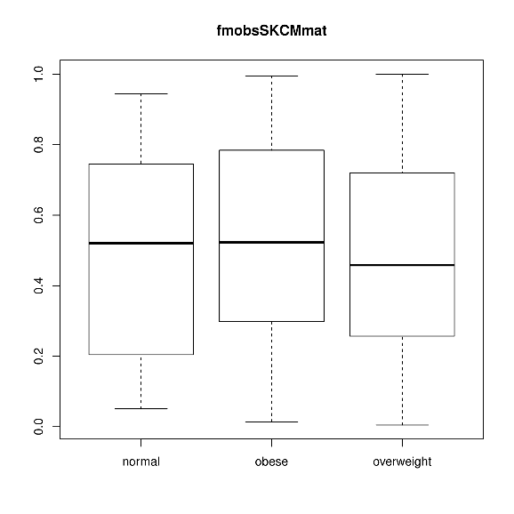
Results – Other Cancer Types
Bladder
Liver
Colon
Endometrial
Rectum
Kidney (papillary)
Cervical (squamous)
Skin

Slide 30
Summary
Showed that SVD was able to obtain the same (if not similar) result for Creighton et al. data set
Both Creighton et al. and Fuentes-Mattei et al. metagenes were able to capture the overall gene expression of the samples from different cancer type
However, these metagenes were not able to separate the samples based on BMI status or BMI value, and therefore cannot be generalized to other cancer types

Slide 31
How can the metagenes capture overall gene expression, but not BMI?

Slide 32
Future Directions
Re-do the analyses using a different data processing program and check/compare the results
Explore other clinical variables and see whether the metagenes correlated with non-BMI variables
- e.g. age, tumour grade, ethnicity
Do differential gene expression analysis on each cancer type for obese vs. normal/overweight samples
Identify common genes across multiple cancer types

Slide 33
Acknowledgement
Supervisor: Mik
Members of the Black lab
Cancer Genetics Lab
SYSKA group
ICGC and TCGA
Images from: https://icgc.org/files/ICGC_Logo_eng_large.jpg and https://pbs.twimg.com/profile_images/467327840174616577/PXOnw28U.png

Slide 34
References
Alexandrov, L.B., Nik-Zainal, S., Wedge, D.C., Aparicio, S.A.J.R., Behjati, S., Biankin, A.V., Bignell, G.R. et al. (2013) Signatures of mutational processes in human cancer. Nature 500, 415 – 421
Creighton, C.J., Sada, Y.H., Zhang, Y., Tsimelzon, A., Wong, H., Dave, B., Landis, M.D., Bear, H.D., Rodriguez, A. and Chang, J.C. (2012) A gene transcription signature of obesity in breast cancer. Breast Cancer Res. Treat. 132, 993 – 1000
Fuentes-Mattei, E., Velazquez-Torres, G., Phan, L., Zhang, F., Chou, P.C., Shin, J.H., Choi, H.H. et al. (2014) Effects of Obesity on Transcriptomic Changes and Cancer Hallmarks in Estrogen Receptor-Positive Breast Cancer. J. Natl. Cancer Inst. 106, dju158
Hanahan, D. and Weinberg, R.A. (2011) Hallmarks of cancer: The next generation. Cell 144, 646 – 674
International Cancer Genome Consortium (2012) International Cancer Genome Consortium. Available: https://icgc.org [16th October 2015]
Lawrence, M.S., Stojanov, P., Mermel, C.H., Robinson, J.T., Garraway, L.A., Golub, T.R., Meyerson, M., Gabriel, S.B., Lander, E.S. and Getz, G. (2014) Discovery and saturation analysis of cancer genes across 21 tumour types. Nature 505, 495 – 501
National Cancer Institute and National Human Genome Research Institute (2015) The Cancer Genome Atlas. Available: http://cancergenome.nih.gov/ [16th October 2015]
National Center for Biotechnology Information (2015) Gene Expression Omnibus. Available: http://www.ncbi.nlm.nih.gov/geo/ [16th October 2015]
World Health Organization (2014) Global status report on noncommunicable diseases 2014. Available: http://www.who.int/nmh/publications/ncd-status-report-2014/en/ [21st October 2015]
World Health Organization (2015) Global database on body mass index. Available: http://apps.who.int/bmi/index.jsp [21st October 2015]

